Slide 1
Markov Chains
Presented by: Abhishek Kumar (20312001)
Guided by: Prof. Chaman Kumar.

Slide 2
Contents
Definition and Construction
Examples
Higher Order Transition Probabilities
Decomposition of state space
Transience and Recurrence
Periodicity
Solidarity Properties
Invariant Measure and Stationary Distribution

Slide 3
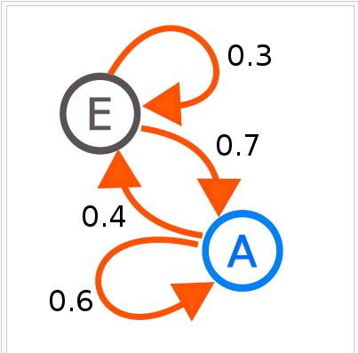
Construction & Definition
Two types of Markov Chains:
DTMC
CTMC

Slide 4
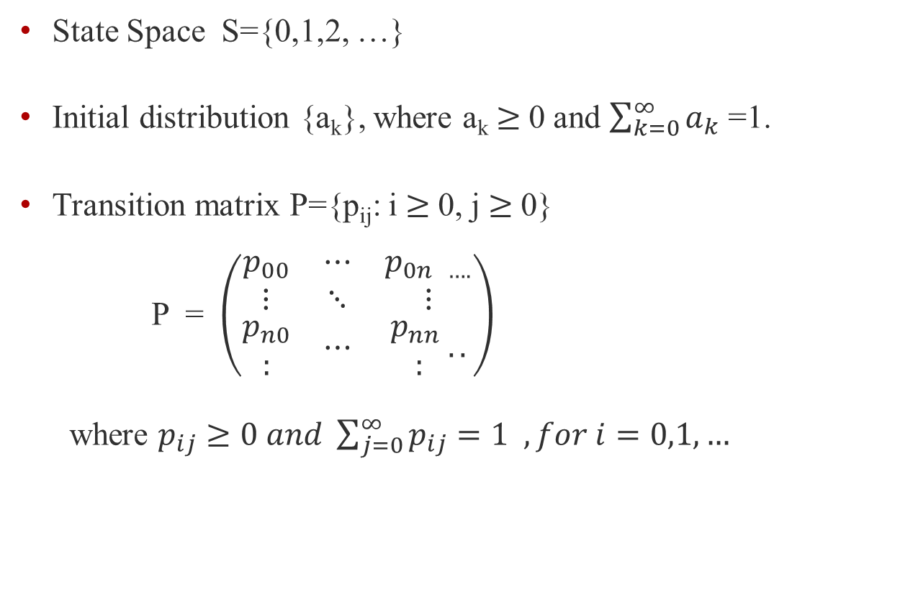
Construction
State Space S={0,1,2, …}
Initial distribution {a_{k}}, where a_{k} $≥$0 and $\sum_{k=0}^{∞}{a_{k}}$ =1.
Transition matrix P={p_{ij}: i $≥$0, j $≥$0} P = $\left(\begin{matrix}p_{00} & ⋯ & p_{0n ….} \\ ⋮ & ⋱ & ⋮ \\ \begin{aligned}p_{n0} \\ :\end{aligned} & ⋯ & \begin{aligned}p_{nn} \\ :\end{aligned}..\end{matrix}\right)$
where $p_{ij}≥0 and \sum_{j=0}^{∞}{p_{ij}=1 , for i=0,1,…}$

Slide 5
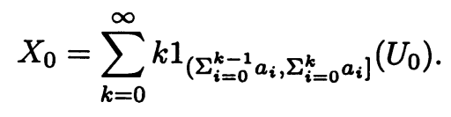
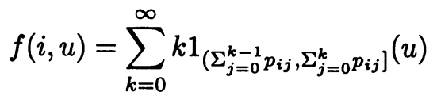
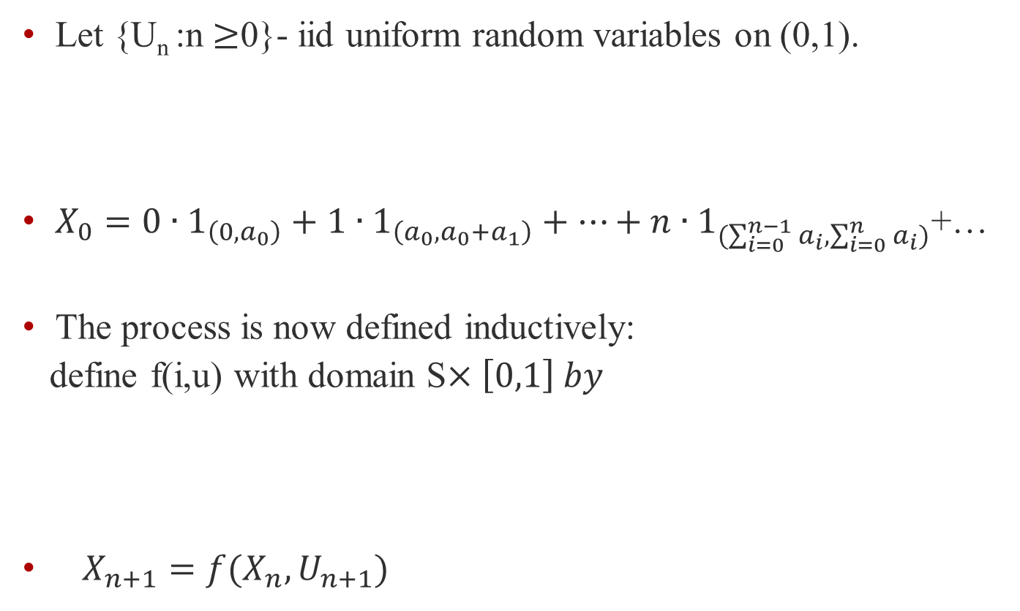
Construction
Let {U_{n} :n $≥$0}- iid uniform random variables on (0,1).
$X_{0}=0∙1_{\left(0,a_{0}\right)}+1∙1_{\left(a_{0},a_{0}+a_{1}\right)}+…+n∙1_{(\sum_{i=0}^{n−1}{a_{i},\sum_{i=0}^{n}{a_{i})}}}$+…
The process is now defined inductively:
define f(i,u) with domain S$×\left[0,1\right] by$
$X_{n+1}=f(X_{n},U_{n+1})$

Slide 6
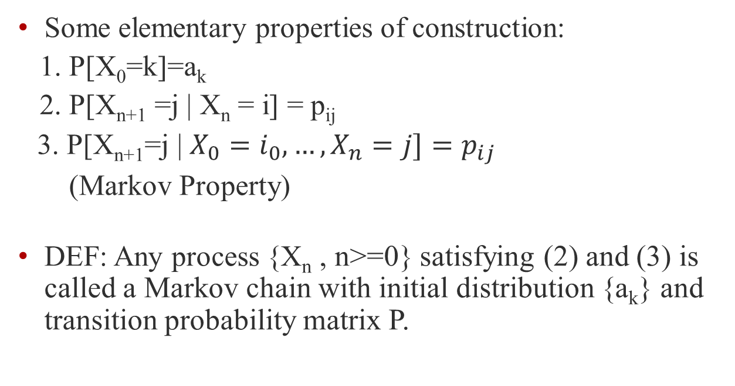
Definition
Some elementary properties of construction:
1. P[X₀=k]=a_{k}
2. P[X_{n+1} =j | X_{n} = i] = p_{ij}
3. P[X_{n+1}=j | $X_{0}=i_{0}, …,X_{n}=j]=p_{ij}$
(Markov Property)
DEF: Any process {X_{n} , n>=0} satisfying (2) and (3) is called a Markov chain with initial distribution {a_{k}} and transition probability matrix P.

Slide 7
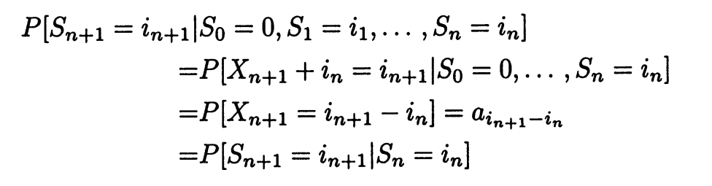
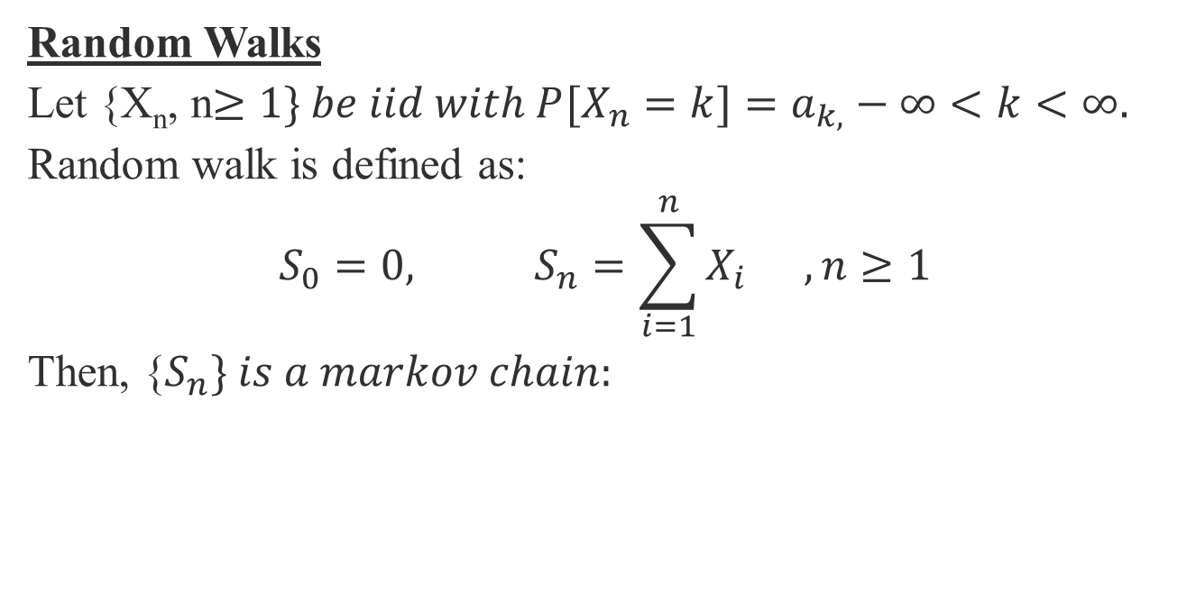
Examples
Random Walks
Let {X_{n}, n$≥1\} be iid with P[X_{n}=k]=a_{k,}−∞<k<∞.$
Random walk is defined as:
$$S_{0}=0, S_{n}=\sum_{i=1}^{n}{X_{i}} ,n≥1$$
Then, {$S_{n}\} is a markov chain:$

Slide 8

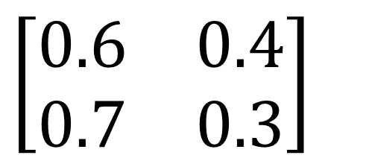
Higher Order Transition Probabilities
A E
A
$$\left[\begin{matrix}0.6 & 0.4 \\ 0.7 & 0.3\end{matrix}\right]$$
E
Claim: P² gives two step transition probabilities

Slide 9

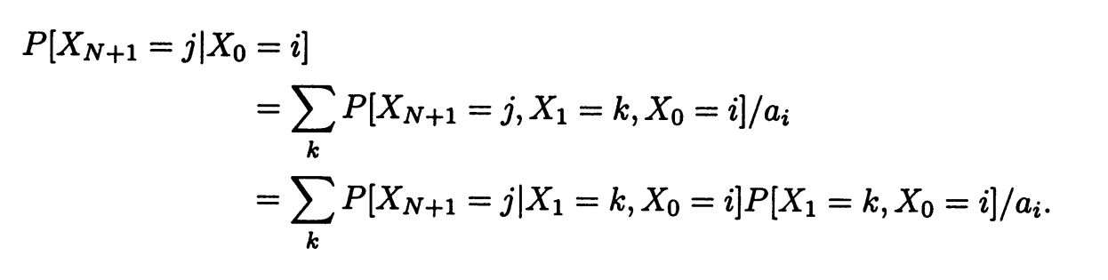
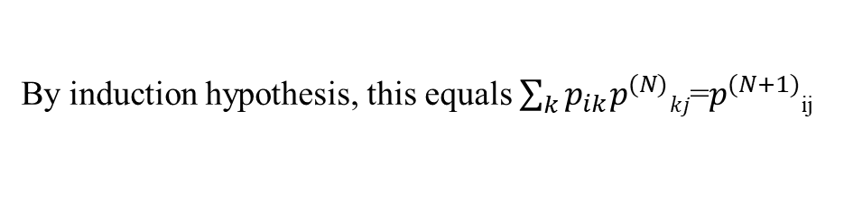
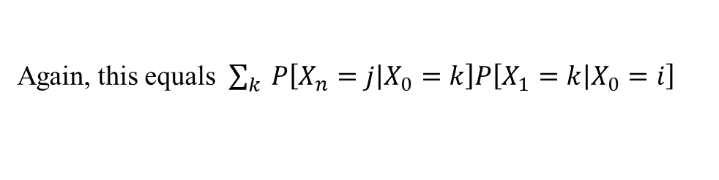
Theorem: $p_{ij}^{}$^{n} = P[X_{n}=j | X_{n}=i] for all i,j in S and n>=0
Proof: Using Mathematical Induction
Formulae is true for n=0,1
Suppose it holds for n=0,1,2…N.
For n=N+1:
Again, this equals $\sum_{k}{P\left[X_{n}=j | X_{0}=k\right]P\left[X_{1}=k | X_{0}=i\right]}$
By induction hypothesis, this equals $\sum_{k}{p_{ik}p_{}^{(N)}kj}$=$p_{}^{(N+1)}$_{ij}

Slide 10
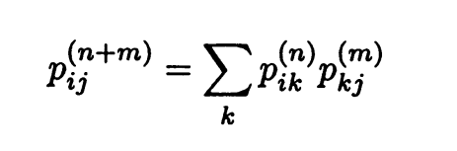

The Matrix identity $P^{n+m}=P^{n}+P^{m}$
In component form,
This equation is called Chapman-Kolmogorov Equation.

Slide 11
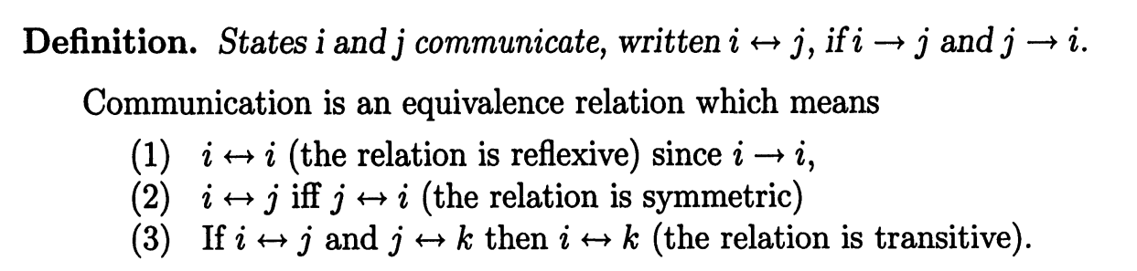
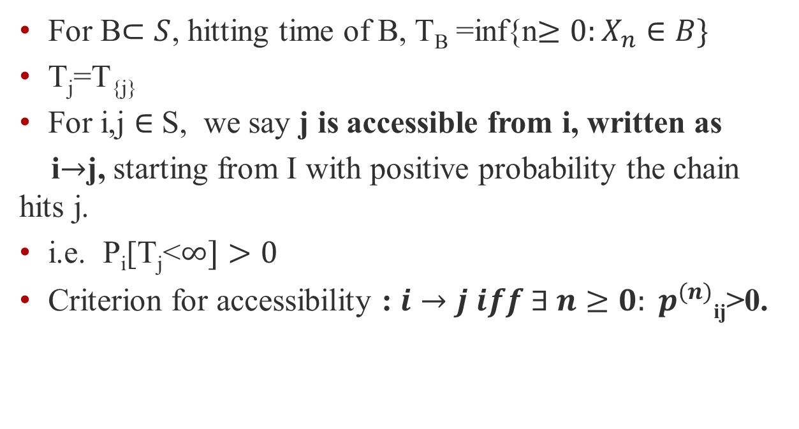
Decomposition of State Space
For B$⊂S$, hitting time of B, T_{B} =inf{n$≥0:X_{n}∈B\}$
T_{j}=T_{{j}}
For i,j $∈$ S, we say j is accessible from i, written as
i$→$j, starting from I with positive probability the chain hits j.
i.e. P_{i}[T_{j}<$∞]>0$
Criterion for accessibility : $i→j iff ∃ n≥0: p_{}^{(n)}$_{ij}>0.

Slide 12

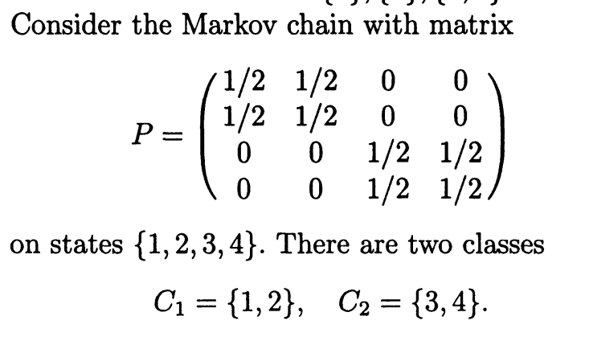
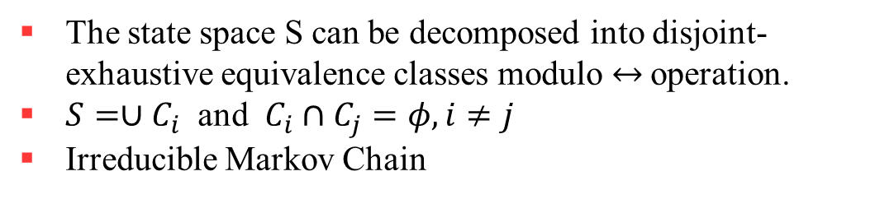
The state space S can be decomposed into disjoint-exhaustive equivalence classes modulo $↔$operation.
$S=∪C_{i}$ and $C_{i}∩C_{j}=φ, i≠j$
Irreducible Markov Chain

Slide 13

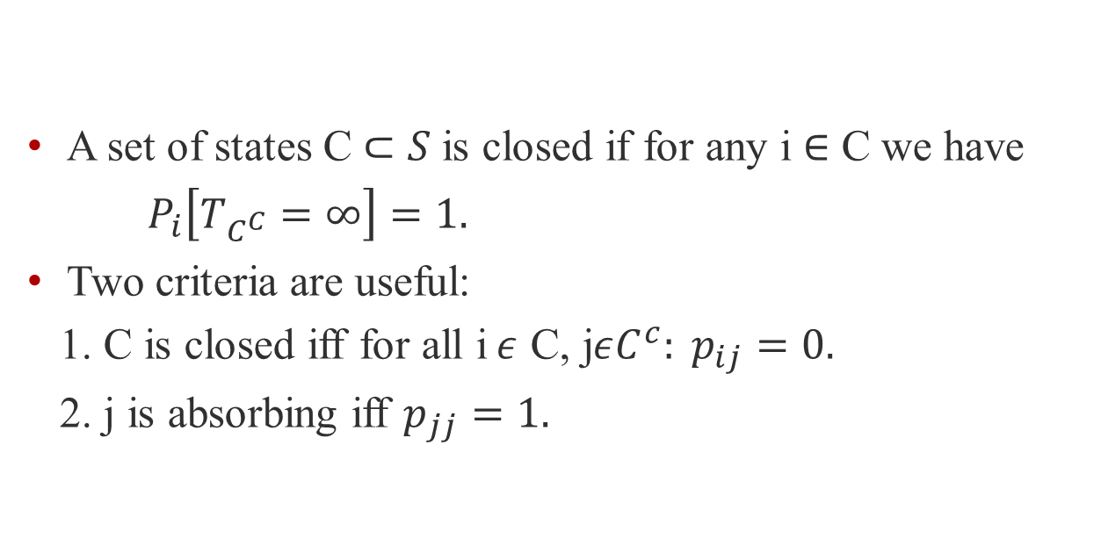
A set of states C $⊂S$is closed if for any i $∈$ C we have
$P_{i}\left[T_{C^{C}}=∞\right]=1.$
Two criteria are useful:
1. C is closed iff for all i$ε$ C, j$εC^{c}: p_{ij}=0.$
2. j is absorbing iff $p_{jj}=1.$

Slide 14
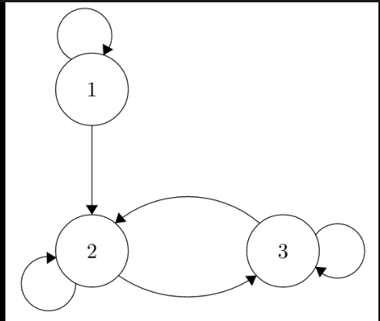
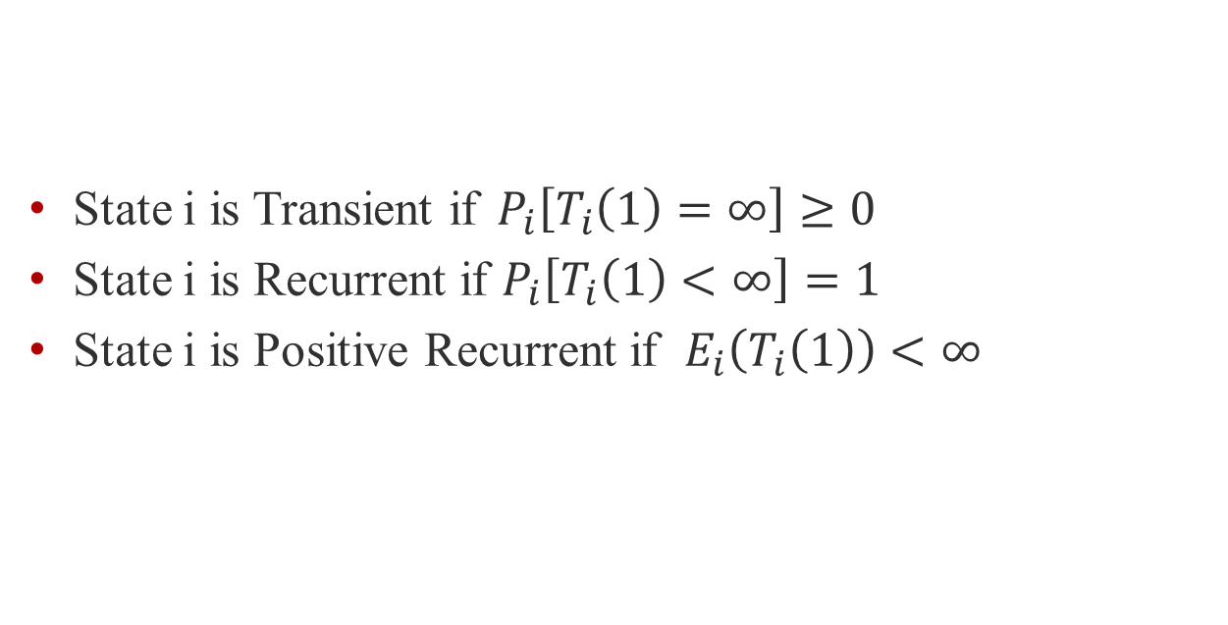
Transience and Recurrence
State i is Transient if${ P}_{i}\left[T_{i}\left(1\right)=∞\right]≥0$
State i is Recurrent if $P_{i}\left[T_{i}\left(1\right)<∞\right]=1$
State i is Positive Recurrent if $E_{i}\left(T_{i}\left(1\right)\right)<∞$
State 1 is Transient, States 2 and 3 are recurrent

Slide 15
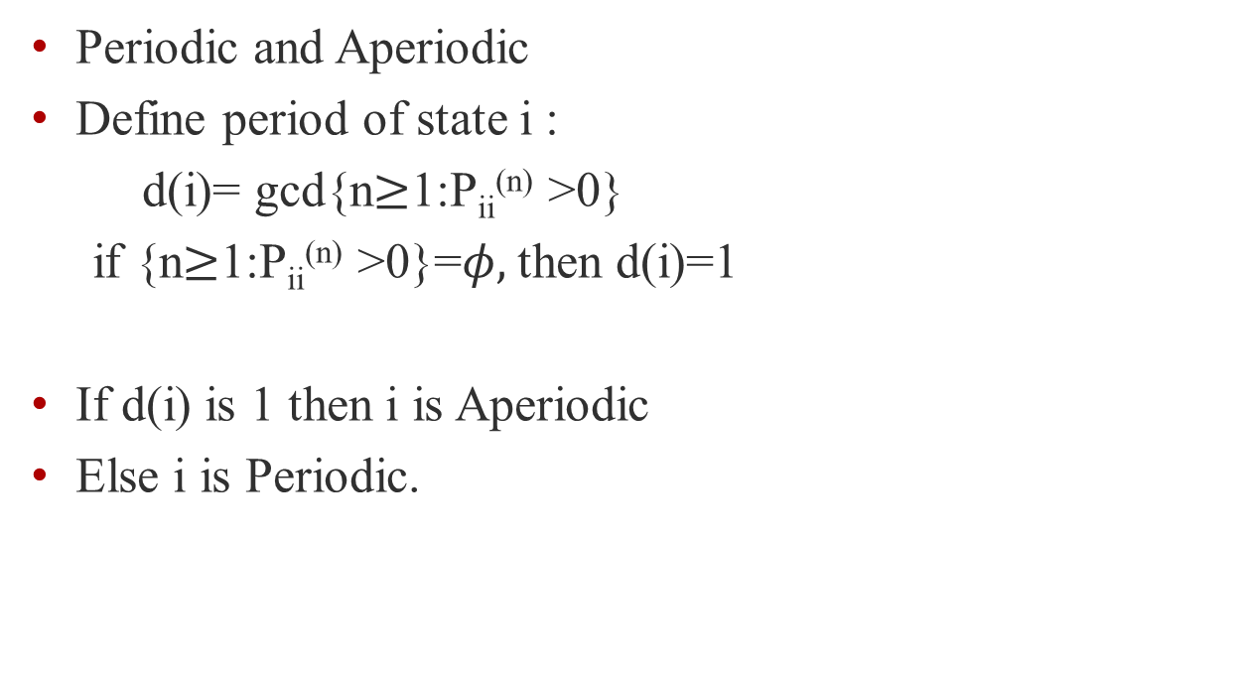
Periodicity
Periodic and Aperiodic
Define period of state i :
d(i)= gcd{n$≥$1:P_{ii}^{(n)} >0}
if {n$≥$1:P_{ii}^{(n)} >0}=$φ,$then d(i)=1
If d(i) is 1 then i is Aperiodic
Else i is Periodic.

Slide 16
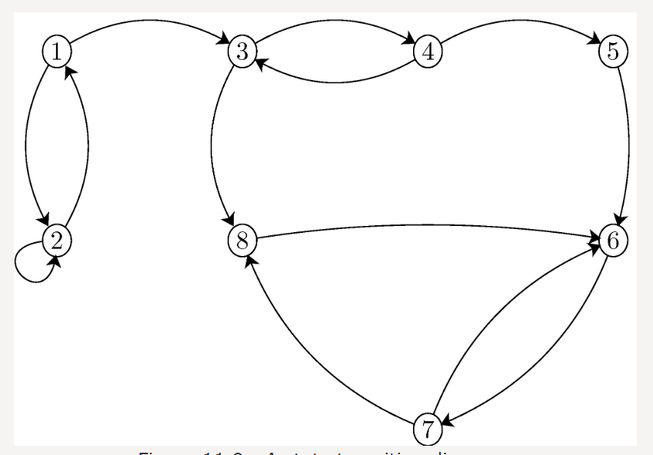
Periodicity
State 2 is Aperiodic, State 1 is Periodic,..

Slide 17
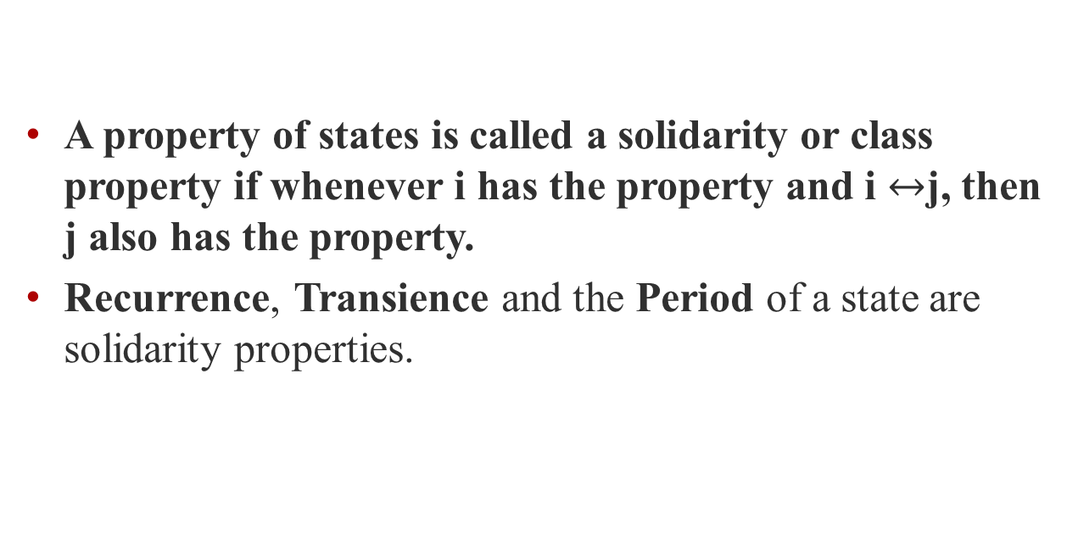
Solidarity Properties
A property of states is called a solidarity or class property if whenever i has the property and i $↔$j, then j also has the property.
Recurrence, Transience and the Period of a state are solidarity properties.

Slide 18
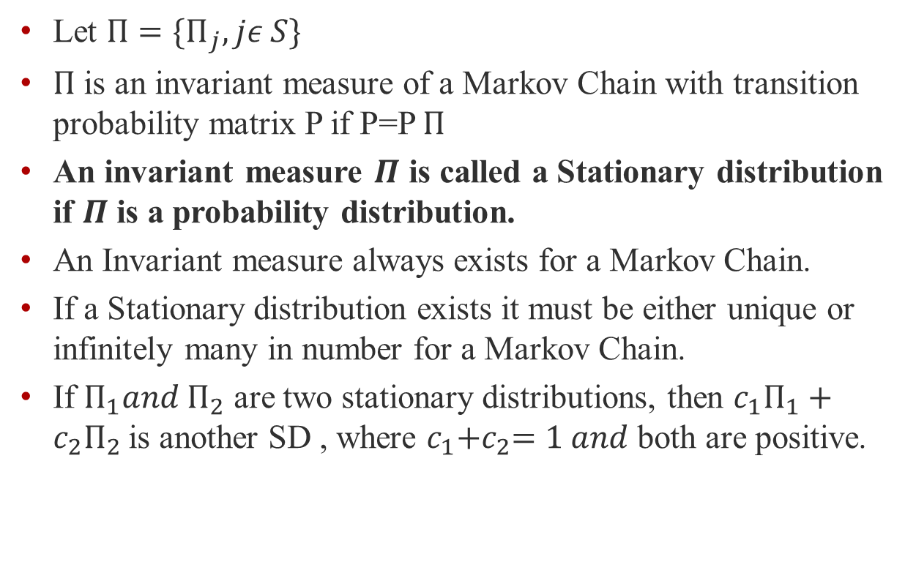
Invariant Measure and Stationary Distribution
Let $Π={\{Π}_{j},jε S\}$
$Π$ is an invariant measure of a Markov Chain with transition probability matrix P if P=P $Π$
An invariant measure $Π$ is called a Stationary distribution if $Π$ is a probability distribution.
An Invariant measure always exists for a Markov Chain.
If a Stationary distribution exists it must be either unique or infinitely many in number for a Markov Chain.
If $Π_{1}{and Π}_{2}$ are two stationary distributions, then $c_{1}Π_{1}+c_{2}Π_{2}$is another SD , where $c_{1}{+c}_{2}=1 and$both are positive.

Slide 19
Thank You
“The Future is Independent of the Past given the Present”

